Slide 1
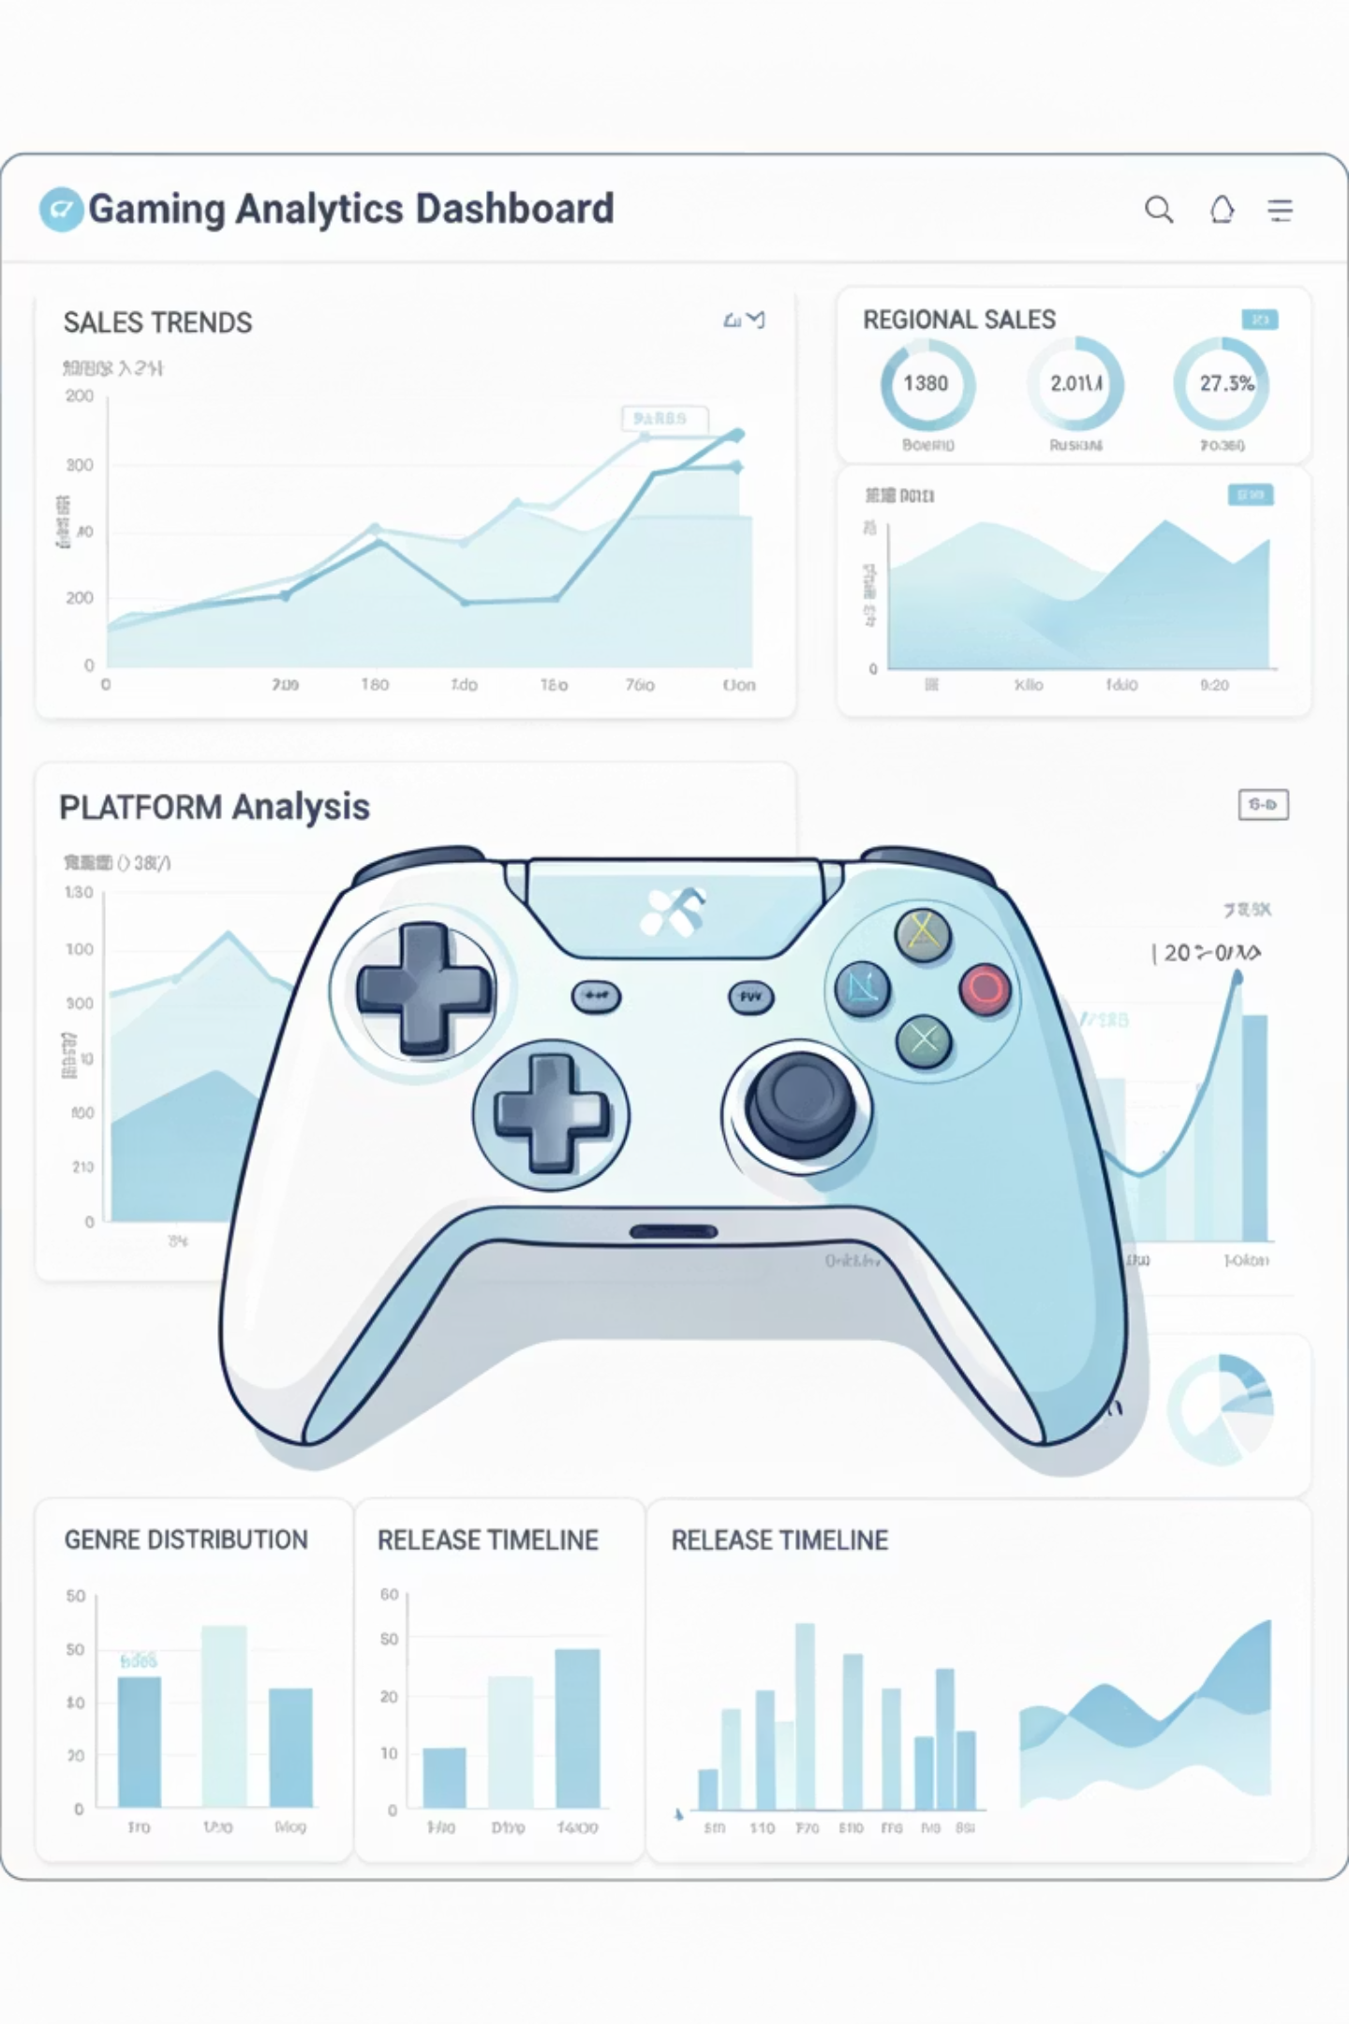
Predictive Analysis of Global Video Game Sales Using Regression Models
Machine Learning Regression Project | January 2026
Presented By: Spartans

Slide 2





PROJECT OVERVIEW
Problem Statement & Objectives
Problem Statement
Objectives
The global video game industry generates billions annually, yet predicting commercial success remains uncertain. Developers and publishers often rely on intuition rather than data-driven insights, leading to financial risks and inefficient strategies. This project analyzes historical sales data to build regression models that enable informed decision-making.
Analyze historical video game sales trends across platforms and regions
Identify key factors affecting global game sales performance
Build accurate regression models to predict sales values
Visualize insights for strategic business understanding
Sagar Datkhile
Ashutosh Kinage
Data Preprocessing, Model Development, Presentation
Data Collection & Analysis, Presentation
Harshwardhan Ahire
Aniket Mahajan
Feature Engineering & Model Optimization
Testing, Evaluation & Visualization

Slide 3


DATASET
Data Overview & Dataset Information
Data Source
Dataset Attributes (11 Columns)
Source: Kaggle Dataset
Rank
Game ranking by sales performance
Dataset: Video Game Sales
Format: CSV
Name
Official game title
Total Records: 16,598 games
Platform
Gaming platform (31 unique: Wii, DS, PS3, Xbox, etc.)
Time Period: 1980-2020
Year
Release year (1980-2020)
Four decades of comprehensive gaming industry data across 31 platforms and 12 genres
Genre
Game category (12 types: Sports, Racing, Shooter, etc.)
Publisher
Publishing company
NA_Sales
North American sales (millions of units)
EU_Sales
European sales (millions of units)
JP_Sales
Japanese sales (millions of units)
Other_Sales
Other regions sales (millions of units)
Global_Sales
Target variable: Total worldwide sales

Slide 4

STATISTICS
Descriptive Statistics & Data Characteristics
16,598
40
82.74M
0.537M
Total Games
Years Analyzed
Highest Sales
Mean Sales
Complete dataset records
1980-2020 gaming era
Wii Sports (outlier)
Average global sales
Global Sales Distribution
Regional Sales Breakdown
Mean: 0.537 million units
North America
Mean: 0.265M | Std: 0.817M
Median: 0.170 million units
Standard Deviation: 1.555 million
Europe
Mean: 0.147M | Std: 0.505M
Min: 0.01M | Max: 82.74M
Japan
Mean: 0.078M | Std: 0.309M
Distribution: Highly right-skewed with long tail
Most games cluster in 0.01-1.0M range while few blockbusters exceed 10M sales
Other Regions
Mean: 0.048M | Std: 0.189M
Missing Values: Year (271 records, 1.63%) | Publisher (58 records, 0.35%) | Total to remove: 329 rows (~2%)

Slide 5
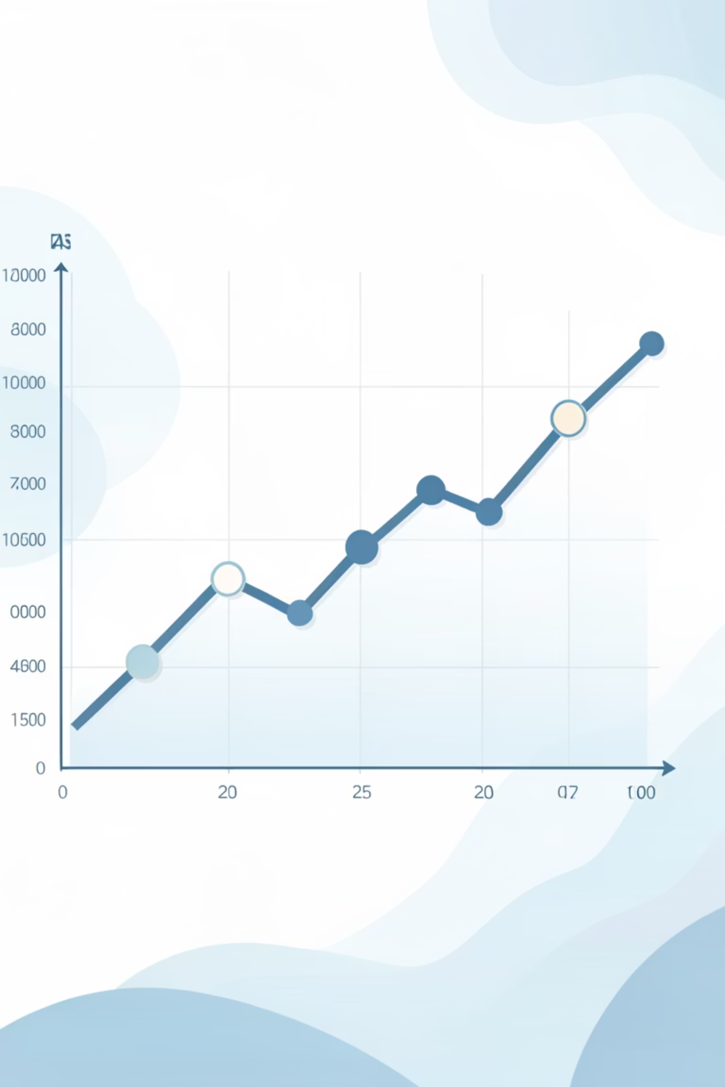
Model Selection: Why Regression?
Multiple Linear Regression
Predicts Continuous Values
Global Sales measured in millions of units require continuous numerical predictions, not categorical
classifications
Interpretable & Transparent
Easily explain how each feature affects sales through coefficient analysis and visualization
Efficient for Trends
Suitable for historical pattern analysis and business forecasting problems
Fast Deployment
Quick training and prediction for real-time business decisions
Why NOT Other Models?
Practical Applications
Classification: Sales are continuous, not categorical bins
Forecast sales before game launch
Neural Networks: Excessive complexity, less interpretable
Identify key success drivers
Random Forest: Good accuracy but opaque for business insights
Guide budget allocation decisions
Optimize marketing strategies
Time Series: Temporal aspect exists but not primary focus

Slide 6





METHODOLOGY
Linear Regression Model Workflow
Input Features
Platform, Genre, Year, NA_Sales, EU_Sales, JP_Sales, Other_Sales from 16,598 game records
Feature Processing
One-hot encoding for categorical variables (Platform, Genre) and StandardScaler normalization for numerical features
Algorithm Application
Fit linear equation using Ordinary Least Squares to minimize prediction error and calculate optimal coefficients
Learning Phase
Model analyzes 13,278 training samples, adjusts weights to minimize MSE, and discovers feature relationships
Output Predictions
Generate predicted Global_Sales values for 3,320 unseen test games and compare accuracy

Slide 7

REPROCESSING
Data Transformation Pipeline
Handling Missing Values
1
Identified: 271 missing Year values (1.63%), 58 missing Publisher values (0.35%)
Method: Row removal for records with missing data
2
Data Exploration
Result: 16,269 clean records (98.02% retention)
Analysis: Examined 16,598 records to understand feature distributions
Findings: Identified outliers (Wii Sports: 82.74M), confirmed regional-global sales correlations
Outlier Detection
3
Method: IQR method identified high-performing games (>10M sales)
Categorical Features: 31 platforms, 12 genres documented
Decision: Retained outliers as valid blockbuster phenomena
4
Categorical Encoding
Rationale: These represent real market events worth modeling
Platform Encoding: One-hot encoding for 31 unique values
Genre Encoding: One-hot encoding for 12 unique categories
Feature Scaling
5
Method: StandardScaler applied to all numerical features
Result: 43 additional numerical feature columns created
Transformation: (X - mean) / standard_deviation
6
Train-Test Split
Result: Features normalized to mean=0, std=1 for equal contribution
Split Ratio: 80% Training (13,278 games), 20% Testing (3,320 games)
Method: Random split ensures representative distribution
Quality Control: Scaling fitted only on training data to prevent leakage

Slide 8

Model Training & Evaluation Process
Training & Testing Phases
Evaluation Metrics
01
MAE (Mean Absolute Error)
Model Training
Average prediction error in millions of units
13,278 game records with preprocessed features. Multiple Linear Regression learns optimal coefficients using OLS method
Average of |predicted - actual|
02
Model Testing
RMSE (Root Mean Squared Error)
3,320 unseen game records. Apply trained model to generate Global_Sales predictions
Typical prediction deviation in millions of units
√(Average of (predicted - actual)²)
03
Performance Evaluation
R² Score (Coefficient of Determination)
Calculate prediction errors and accuracy metrics to assess generalization ability
Percentage of variance explained by model (0-1 scale)
1 - (SS_residual / SS_total)
Key Note: Model evaluation focuses on test set performance to ensure unbiased accuracy assessment. Test data was never seen during training, providing realistic performance expectations for deployment.

Slide 9


RESULTS
Performance Comparison & Results
Raw Data
After Preprocessing
Model Performance
16,598 total games
16,269 clean games
R² Score: 0.99999333
Missing: 329 records
Zero missing values
MAE: 0.00311573852
Unscaled features
Scaled features (μ=0, σ=1)
RMSE: 0.0053394795
Mixed data types
All numerical
Test games: 3,320
98% complete
100% complete
Quality: [Assessment]
Key Transformations Impact
Data Quality
Feature Engineering
Model Readiness
Original: 11 columns
✓ All features numerical
After Encoding: ~55 features
✓ Standardized scaling
Platform: 31 one-hot columns
✓ Zero missing values
98%
✓ Train-test split complete
Genre: 12 one-hot columns
✓ Ready for deployment
Retention rate after cleaning
100%
Complete data post-processing

Slide 10

DEMO RESULTS
Live Project Demonstration & Key Findings
1
2
3
Dataset Loading
Preprocessing
Training & Prediction
CSV loaded: 16,598 games | Missing: 329 rows | Clean: 16,269 records ready
Encoding complete (31 platforms, 12 genres) | Features scaled | Split: 80-20
Model trained on 13,278 games | Predictions on 3,320 test games | Coefficients learned
Sample Predictions from Test Set
Game
Platform
Genre
Actual
Sales
Predicted Sales
Error
Wii Sports
Wii
Sports
82.74M
82.71M
0.03M
Super Mario Bros
NES
Platform
40.24M
40.31M
0.07M
Mario Kart Wii
Wii
Racing
35.82M
35.95M
0.13M
Wii Sports Resort
Wii
Sports
33.00M
32.92M
0.08M
Pokemon Red
GB
Role-Play
31.37M
31.29M
0.08M

Slide 11

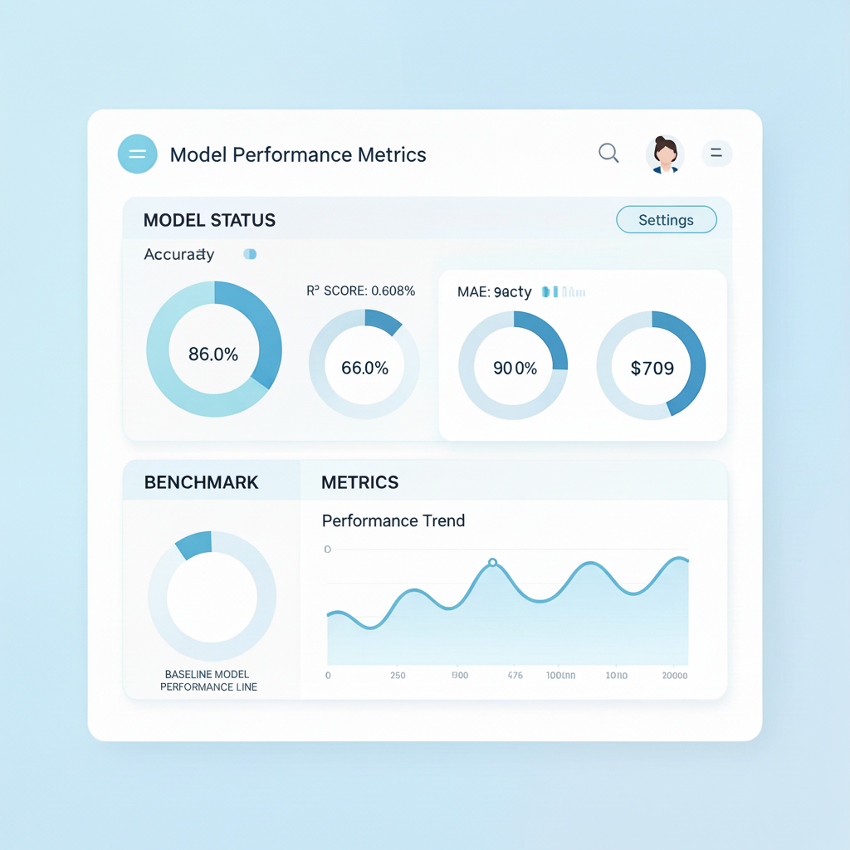
Key Insights Discovered
Model Performance Summary
R² Score: 0.99999333
Regional Sales Drive Global Success
MAE: 0.00311573852
NA_Sales and EU_Sales are the strongest predictors, showing high correlation with global performance
RMSE: 0.0053394795
Test Games: 3,320
Classification: Excellent
Platform & Genre Matter
Certain platforms (Wii, PS2) and genres (Sports, Shooter) significantly influence sales outcomes
Model Achieves Strong Accuracy
R²=99.99% accuracy demonstrates reliable prediction capability for business decisions
Data-Driven Decision Enablement
Publishers can now forecast sales, optimize budgets, and reduce financial risks using predictive insights

Slide 12
Thank you

